Slide 1
Predicting Churn in SyriaTel Customers
By Crispus Wanene
SyriaTel
PROJECTS
15/09/2025
A Data-Driven Strategy to Reduce Customer Loss

Slide 2
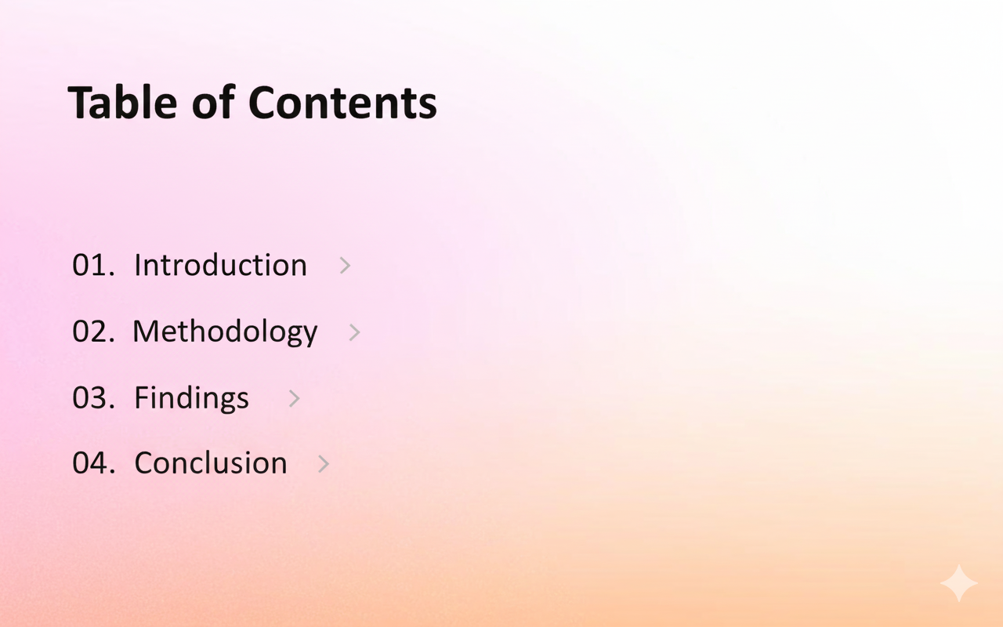


Slide 3
Introduction
01
SyriaTel Customer Analysis

Slide 4

Introduction
We want to reduce customer churn (leave) by identifying which customers are likely to leave. Churn is costly, so catching high-risk customers early allows targeted retention efforts, like special offers or support.
This presentation aims to present our key findings and recommendations to reduce SyriaTel’s customer loss.

Slide 5
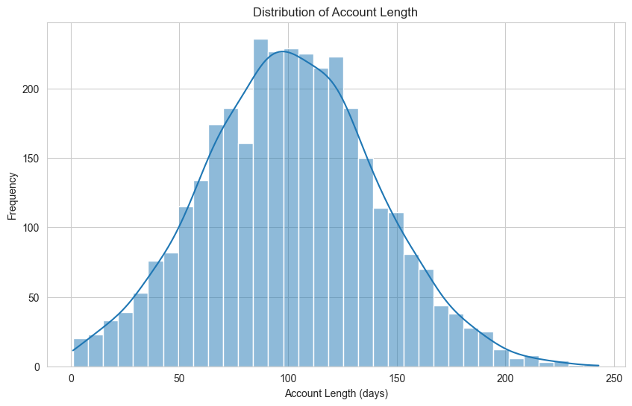
Customer Loss and Impact
SyriaTel loses customers after about 100 days on average. Churn is costly, so catching high-risk customers early allows targeted offers and support. This presentation shows key findings and recommendations to reduce customer loss.

Slide 6
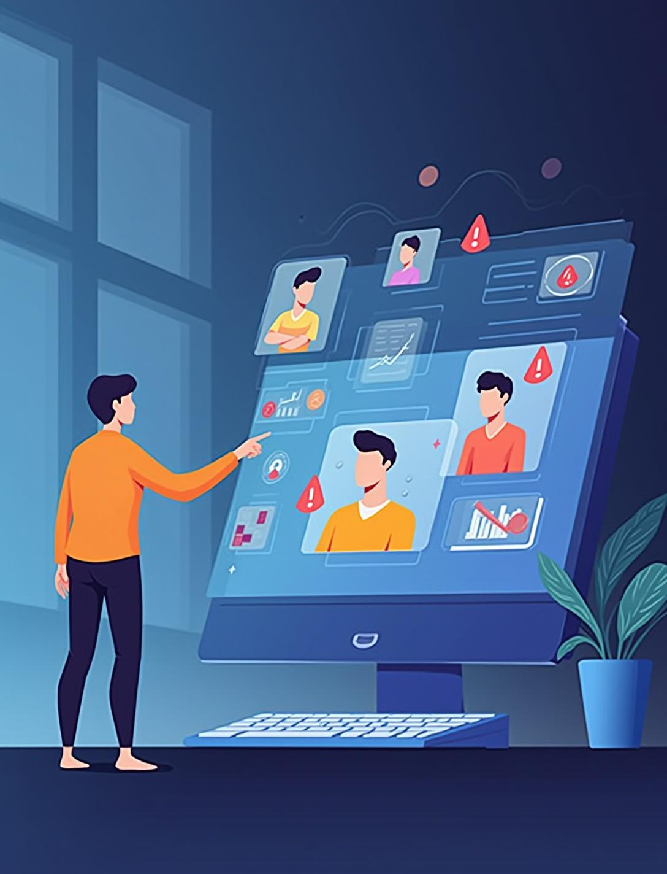
Opportunity Insights
Predictive insights offer a chance to reduce churn by identifying at-risk customers early and enabling proactive retention efforts.

Slide 7
Methodology
02
SyriaTel Customer Analysis

Slide 8
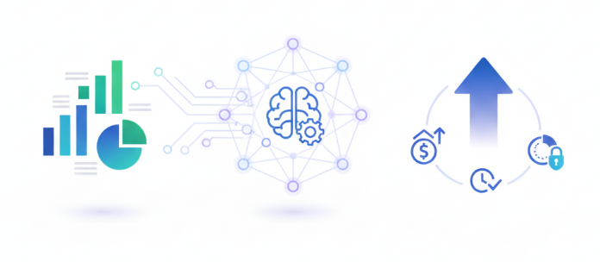
Data & Analysis Approach
Our Analytical Approach:
Analyzed 3,333 customers with complete behavioral data
2. Applied statistical testing to prove which factors drive churn
3. Built predictive model catching 75% of potential churners

Slide 9
Findings 03

Slide 10
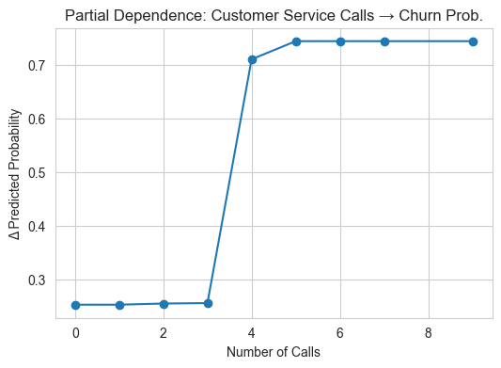
Service Frustration
After 3 service calls, churn probability jumps from 10% to 50%. Companies like Southwest Airlines have built strong brand reputations on the foundation of exceptional customer service.
We can also improve self-service options to resolve issues quickly and prevent dissatisfaction from escalating.
We should prioritize following up on customers who place more than 3 calls, and incentivizing them with offers such as free data after the follow-up.

Slide 11
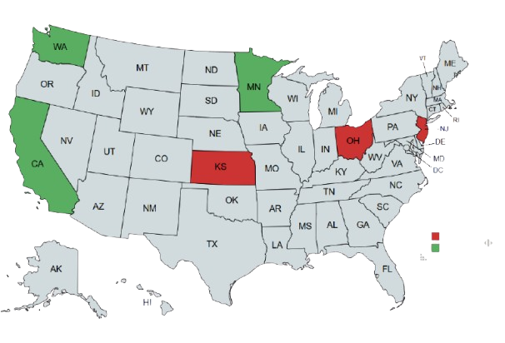
Geographical Focus
New Jersey, Kansas and Ohio are the most at-risk state for churning.
Concentration allows for targeted interventions
Companies like Comcast have implemented localized promotions to counter competitor activity in specific regions.
This targeted approach is more efficient and effective than a one-size-fits-all strategy.

Slide 12
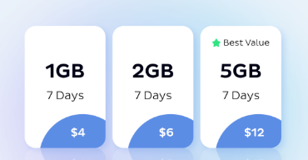
Billing Surprises
International plan customers churn at 42% vs. the 11% that churn without plans. "Bill shock" from unexpected charges drives defection. We recommend introducing tiered pricing models that provide better value and reward heavy consumption.
e.g. Calling for 200 minutes and getting 100 minutes free.

Slide 13
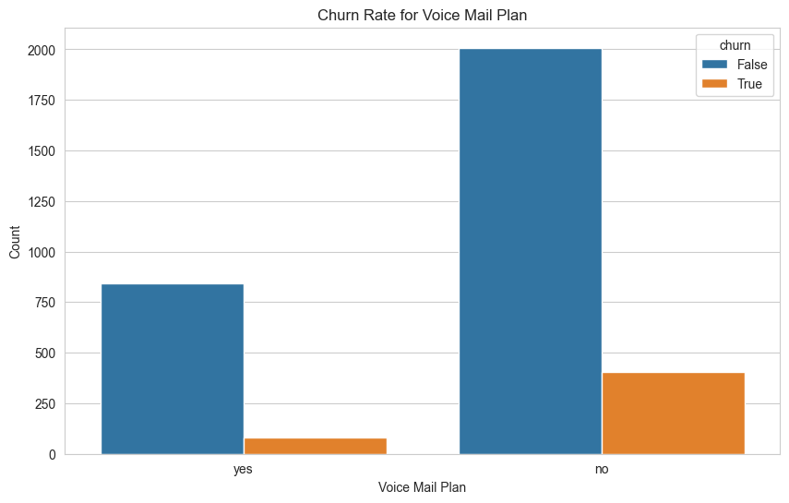
Increase Value Through Service Bundling
There are about 9% churned customers with a voice mail plan and roughly 17% churned customers without a voice mail plan.
Strategically package core services with value-add features to increase perceived value and enhance customer loyalty.
The Amazon Prime model, which bundles shipping, streaming, and other perks, is a prime example of this strategy.
We recommend having current data packages include a complementary voicemail package, as voicemail increases retention.

Slide 14
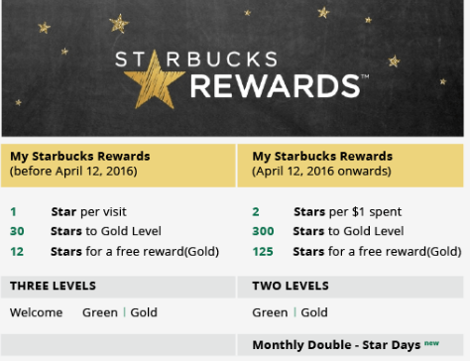
Introduce a Tiered Loyalty Program
Develop a modern loyalty program that offers both long-term benefits.
Give personalized, immediate rewards to retain high-value customers.
Tiered system used by the Starbucks rewards program is a successful example of driving repeat business.
We recommend offering recurring offers and gifts to high-spending customers to discourage churning

Slide 15
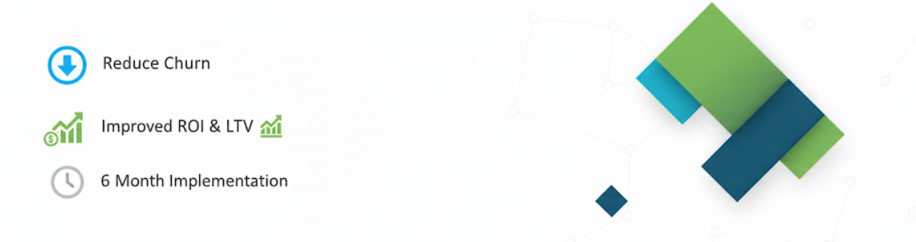
Conclusions
Expected to reduce churn by 20-30%, protecting revenue and lowering acquisition costs. Full implementation within 6 months promises strong ROI and improved customer lifetime value.

Slide 16









THANK YOU
Do you have any questions?
chrismbici@gmail.com
+254 716 424 359
cris-mbici.com

